Slide 1


SMART INDIA HACKATHON 2025
TITLE PAGE
Problem Statement ID – 25034
Problem Statement
AI-Based Internship Recommendation Engine for PM Internship Scheme
Theme- Smart Automation
PS Category- Software
Team ID- 133
Team Name- SQUIDERS

Slide 2

IDEA TITLE
SQUIDERS
Proposed Solution (Describe your Idea/Solution/Prototype)
Solution Overview
1) AI/ML-powered matchmaking system
2) Skill, location & sector filtering
Problem Addressed
1) Fairness via diversity parameters
2) Optimized allocation using past data
Unique Features
1) Intuitive, user-friendly interface
2) Demonstrative front-end prototype

Slide 3
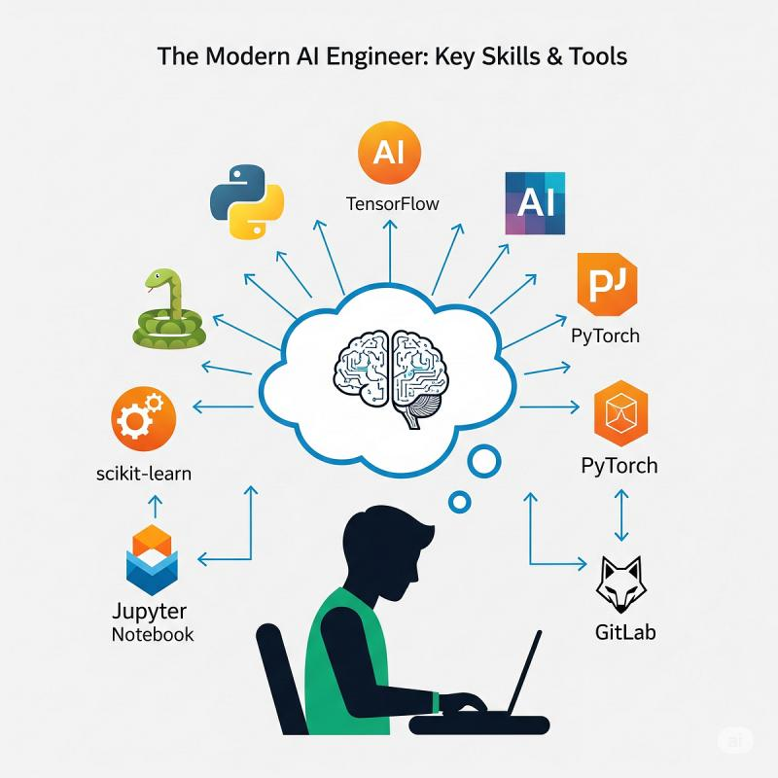
TECHNICAL APPROACH
SQUIDERS
TECH STACK TABLE
Component | Technology Used
Programming | JavaScript
Backend API | Node.js with Express.js API
Frontend | React
Database | Fire Base
Hosting | Vercel
Responsive | All Devices

Slide 4

FEASIBILITY AND VIABILITY
SQUIDERS
Scalable deployment (cloud-ready, open-source)
Challenges:
Fairness, privacy, reliability
Solutions:
Data anonymization, bias mitigation, robust testing
Can handle thousands of applicants efficiently
Adaptable to future government schemes

Slide 5

IMPACT AND BENEFITS
SQUIDERS
Efficient, transparent placement process for students
Promotes inclusion (rural/social categories)
Reduces manual intervention and bias
Speeds up internship process, workforce readiness
Strong social and economic benefits

Slide 6
RESEARCH AND REFERENCES
SQUIDERS
Navigating techniques in job recommender systems on internship profile matching [1]
A challenge-based survey of e-recruitment recommendation systems [2]
A Deep Hybrid Model for Recommendation Systems [3]
Help Me Find a Job: A Graph-based Approach for Job Recommendation at Scale [4]

